Slide 1
Data and Models
E²M²: Ecological and Epidemiological Modeling in Madagascar
Centre ValBio
Ranomafana National Park, Madagascar
13 – 20 January, 2019

Slide 2


Thanks to our sponsors!
Lecture contributions from:
Tanjona Ramiadantso
Steve Bellan

Slide 3

International Clinics on Infectious Disease, Dynamics, & Data

Slide 4
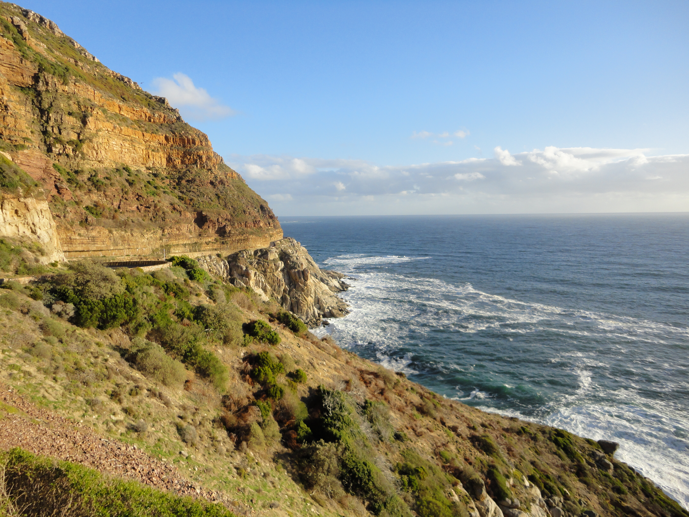
International Clinics on Infectious Disease, Dynamics, & Data
MMED: Clinic on the Meaningful Modeling of Epidemiological Data
May-June 2019, Cape Town, South Africa

Slide 5
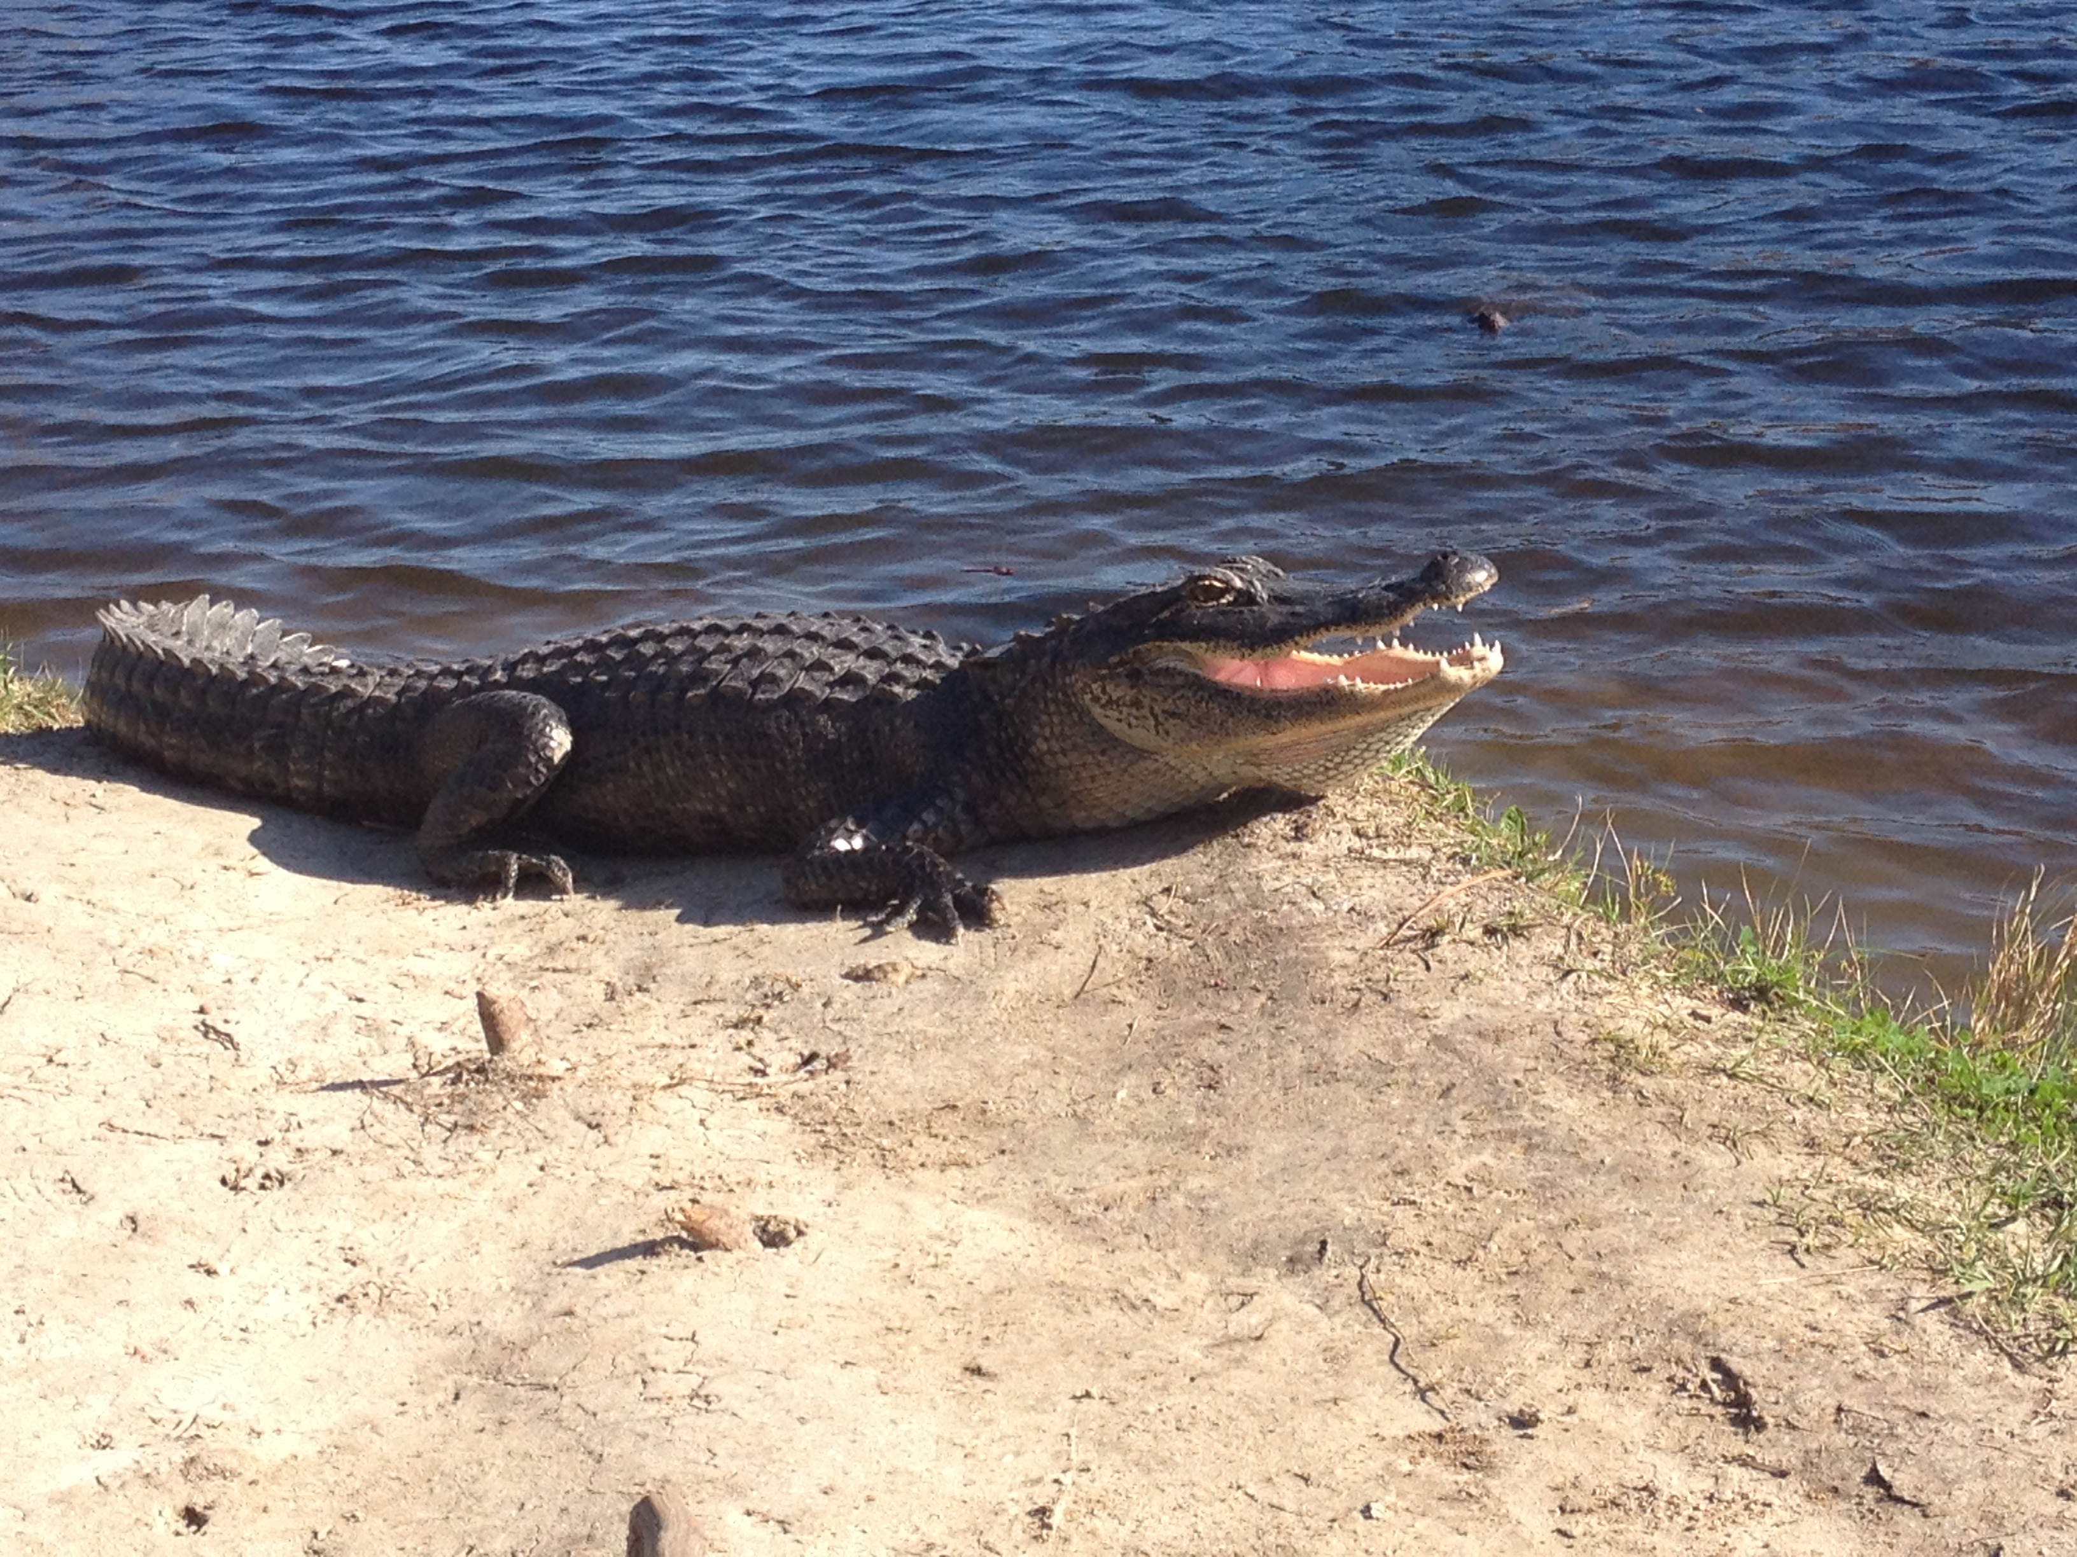
International Clinics on Infectious Disease, Dynamics, & Data
MMED: Clinic on the Meaningful Modeling of Epidemiological Data
May-June 2019, Cape Town, South Africa
DAIDD: Clinic on Dynamical Approaches to Infectious Disease Data
December 2019, Florida, USA

Slide 6
International Clinics on Infectious Disease, Dynamics, & Data
MMED: Clinic on the Meaningful Modeling of Epidemiological Data
May-June 2019, Cape Town, South Africa
DAIDD: Clinic on Dynamical Approaches to Infectious Disease Data
December 2019, Florida, USA
South African Center for Epidemiological Modeling and Analysis (SACEMA), Director
Dr. Juliet Pulliam
University of Stellenbosch
ICI3D, Program Director
Dr. Steve Bellan
University of Georgia

Slide 7
International Clinics on Infectious Disease, Dynamics, & Data
www.ici3d.org

Slide 8
Goals for this lecture
To explain what we’re doing here

Slide 9
Goals for this lecture
To explain what we’re doing here
To define “science”

Slide 10
Goals for this lecture
To explain what we’re doing here
To define “science”
To define “data”

Slide 11
Goals for this lecture
To explain what we’re doing here
To define “science”
To define “data”
To define “models”

Slide 12
Goals for this lecture
To explain what we’re doing here
To define “science”
To define “data”
To define “models”
To introduce many different types of models

Slide 13
Goals for this lecture
To explain what we’re doing here
To define “science”
To define “data”
To define “models”
To introduce many different types of models
Statistical

Slide 14
Goals for this lecture
To explain what we’re doing here
To define “science”
To define “data”
To define “models”
To introduce many different types of models
Statistical
Mathematical

Slide 15
Goals for this lecture
To explain what we’re doing here
To define “science”
To define “data”
To define “models”
To introduce many different types of models
Statistical
Mathematical
To introduce the “E” in E²M²

Slide 16
Goals for this lecture
To explain what we’re doing here
To define “science”
To define “data”
To define “models”
To introduce many different types of models
Statistical
Mathematical
To introduce the “E” in E²M²
Ecology

Slide 17
Goals for this lecture
To explain what we’re doing here
To define ”science”
To define ”data”
To define “models”
To introduce many different types of models
Statistical
Mathematical
To introduce the “E” in E²M²
Ecology
Epidemiology

Slide 18
All course materials are available at:
https://carabrook.github.io/E2M2/E2M2_2019.html

Slide 19
Saturday: R Bootcamp
Intro to R Studio
Exploring and Visualizing Data in R
For-loops, Functions, and If-Else Statements
● Programming
● Data
● Models
● Research Development
Thursday: “Fitting Models to Data”
● Model Fitting in Practice – the Basic Concept
● Introduction to Occupancy Modeling
● Intro to Spatial Modeling
● Occupancy modeling in R
● Epidemic Cards
● Model Fitting with Epidemic Cards
● Model Telephone
Sunday: Travel
Friday: “Refining Your Work”
● Intro to Network Modeling
● Model Selection and Comparison
● Modeling Vector-Borne Disease
● Final research plans
Monday: “Dealing with Data”
● Data and Models
● Student introductions & presentations
● Linear regression & simple stats
● Basic statistical modeling in R
● Formulating research questions
Wednesday: “Thinking About Mechanism”
● Intro to Compartmental Models & Differential Equations
● Building mechanistic models in R
● Defining a model world
● Refining research questions for modeling
● Discussion of a scientific paper
● Mentor research presentations
Saturday: “Putting it All in Perspective”
● Modeling in Practice: The Lifecycle of a Modeling Project
● Research snapshots
Tuesday: “Deeper Thinking About Data”
● Dynamical Fever
● Intro to Mixed Modeling
● Mixed modeling in R
● Study Design and Data Collection
● Refining research questions for modeling
Sunday: Travel
Monday: “Sharing Your Work”
● Final student presentations

Slide 20
What is science?
the systematic observation of natural events and conditions in order to discover facts about them and to formulate laws and principles based on these facts.
– Academic Press Dictionary of Science & Technology

Slide 21
Observations and Laws and Principles

Slide 22
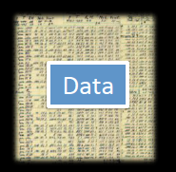
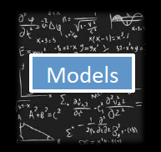
Data and Models
Models

Slide 23
Data and Models
What is data?

Slide 24
Data and Models
What is data?
Backbone of science

Slide 25
What is science?
the systematic observation of natural events and conditions in order to discover facts about them and to formulate laws and principles based on these facts.
– Academic Press Dictionary of Science & Technology

Slide 26
Data vs. Models
What is data?
Backbone of science
Evidence to support a claim

Slide 27
Data or not data?
19

Slide 28
Data or not data?
19
19 = total number of fingers and toes

Slide 29
Data or not data?
19
19 = total number of fingers and toes
19 = total number of fingers and toes of Andry Rajoelina

Slide 30
Data or not data?
19
19 = total number of fingers and toes
19 = total number of fingers and toes of Andry Rajoelina
This is a fact. It becomes data when we use it to support a claim.
There is a negative correlation between the number of years someone has served as president of Madagascar and their total number of fingers and toes.

Slide 31
Data or not data?
5, 11, 27

Slide 32
Data or not data?
5, 11, 27
5, 11, 27 = respective # of children belonging to Amy, Christian, & Ben

Slide 33
Data or not data?
5, 11, 27
5, 11, 27 = respective # of children belonging to Amy, Christian, & Ben
5, 11, 27 = respective # of children belonging to Amy, Christian, & Ben.
Amy, Christian, & Ben are the names of tenrecs at Duke Lemur Center

Slide 34
Data or not data?
5, 11, 27
5, 11, 27 = respective # of children belonging to Amy, Christian, & Ben
5, 11, 27 = respective # of children belonging to Amy, Christian, & Ben.
Amy, Christian, & Ben are the names of tenrecs at Duke Lemur Center
This is a fact.

Slide 35
Data or not data?
5, 11, 27
5, 11, 27 = respective # of children belonging to Amy, Christian, & Ben
5, 11, 27 = respective # of children belonging to Amy, Christian, & Ben.
Amy, Christian, & Ben are the names of tenrecs at Duke Lemur Center
This is data to support the claim:
Tenrecs have high fecundity rates.

Slide 36
Data or not data?
5, 11, 27
5, 11, 27 = respective # of children belonging to Amy, Christian, & Ben
5, 11, 27 = respective # of children belonging to Amy, Christian, & Ben.
Amy, Christian, & Ben are the names of tenrecs at Duke Lemur Center
This is data to support the claim:
Tenrecs have high fecundity rates.

Slide 37
What is data?
Backbone of science
Evidence to support a claim
A relationship between at least two variables
x: explanatory, control, driver, independent variable(s)
y: response, dependent variable(s)
x and y should be clearly defined
with respect to the question!

Slide 38
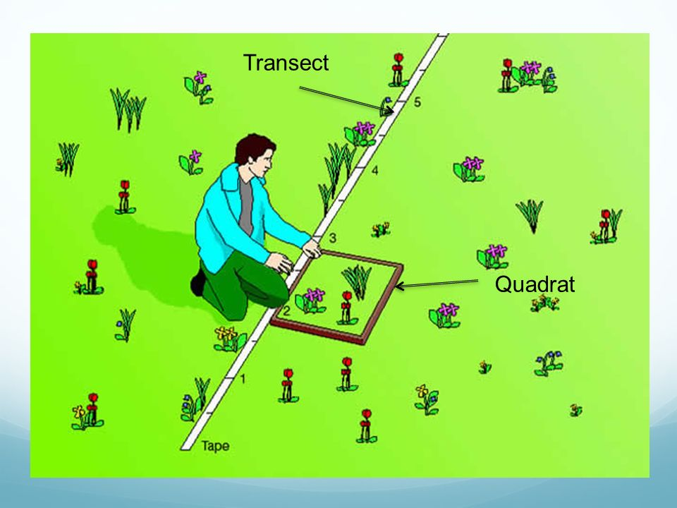
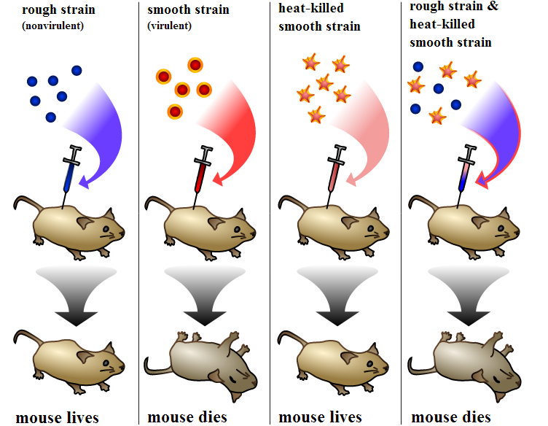
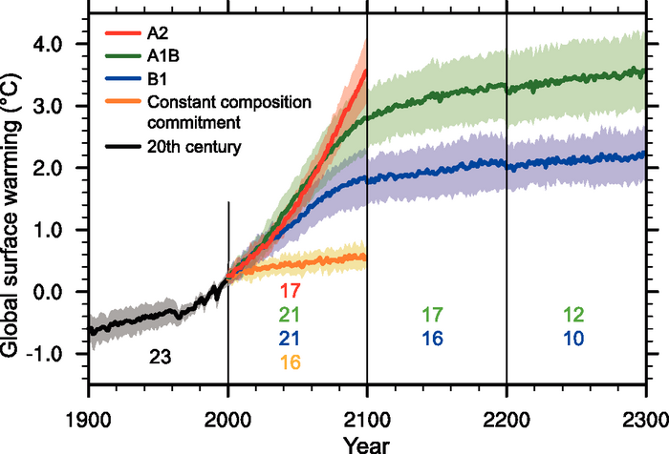
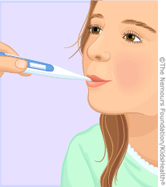
Data: Sources of x and y
Observational | Experimental | Simulated
- Just measure x and y | - Interfere with x or the relationship between x and y | - Create a relationship between x and y
Empirical data

Slide 39
Data: Types
Numerical
Categorical

Slide 40
Data: Types
Numerical
A variable is numerical when you can transform it with mathematical operation
Examples?
Categorical

Slide 41
Data: Types
Numerical
A variable is numerical when you can transform it with mathematical operation
Examples?
Integer, real number, multi-dimensional number
Categorical

Slide 42
Data: Types
Numerical
A variable is numerical when you can transform it with mathematical operation
Examples?
Integer, real number, multi-dimensional number
Categorical
A variable is categorical when it is not numerical but a categorical can be numerical?
Examples?

Slide 43
Data: Types
Numerical
A variable is numerical when you can transform it with mathematical operation
Examples:
Integer, real number, multi-dimensional number
Categorical
A variable is categorical when it is not numerical but a categorical can be numerical?
Examples:
Colors, (blood) types, species name

Slide 44
Data: Things to consider
Data acquisition

Slide 45
Data: Things to consider
Data acquisition
Impossible, example?

Slide 46
Data: Things to consider
Data acquisition
Impossible, example?
Theoretically possible but practically unfeasible, examples?

Slide 47
Data: Things to consider
Data acquisition
Impossible, example?
Theoretically possible but practically unfeasible, examples?
Data quality and quantity
In practice there is always a trade-off

Slide 48
Data: Things to consider
Data acquisition
Impossible, example?
Theoretically possible but practically unfeasible, examples?
Data quality and quantity
In practice there is always a trade-off
Example: monetary cost, human effort -> power analysis, sampling design etc.

Slide 49
Data: Things to consider
Data acquisition
Impossible, example?
Theoretically possible but practically unfeasible, examples?
Data quality and quantity
In practice there is always a trade-off
Example: monetary cost, human effort -> power analysis, sampling design etc.
Reproducibility

Slide 50
Data: Things to consider
Data acquisition
Impossible, example?
Theoretically possible but practically unfeasible, examples?
Data quality and quantity
In practice there is always a trade-off
Example: monetary cost, human effort -> power analysis, sampling design etc.
Reproducibility
Measurement errors

Slide 51
Data: Things to consider
Data acquisition
Impossible, example?
Theoretically possible but practically unfeasible, examples?
Data quality and quantity
In practice there is always a trade-off
Example: monetary cost, human effort -> power analysis, sampling design etc.
Reproducibility
Measurement errors
Examples?

Slide 53
Data and Models
Models

Slide 54
Data vs. Models
Models
What is a model?

Slide 55
What is science?
the systematic observation of natural events and conditions in order to discover facts about them and to formulate laws and principles based on these facts.
– Academic Press Dictionary of Science & Technology

Slide 56
Laws and Principles
Models
A theory = a declaration to explain a phenomenon
Logical and falsifiable
A model = an abstract representation of a phenomenon
A hypothesis = a testable declaration that is derived from a theory

Slide 57
Theory, Models, Hypotheses
Theory General
Model
Hypothesis Specific

Slide 58

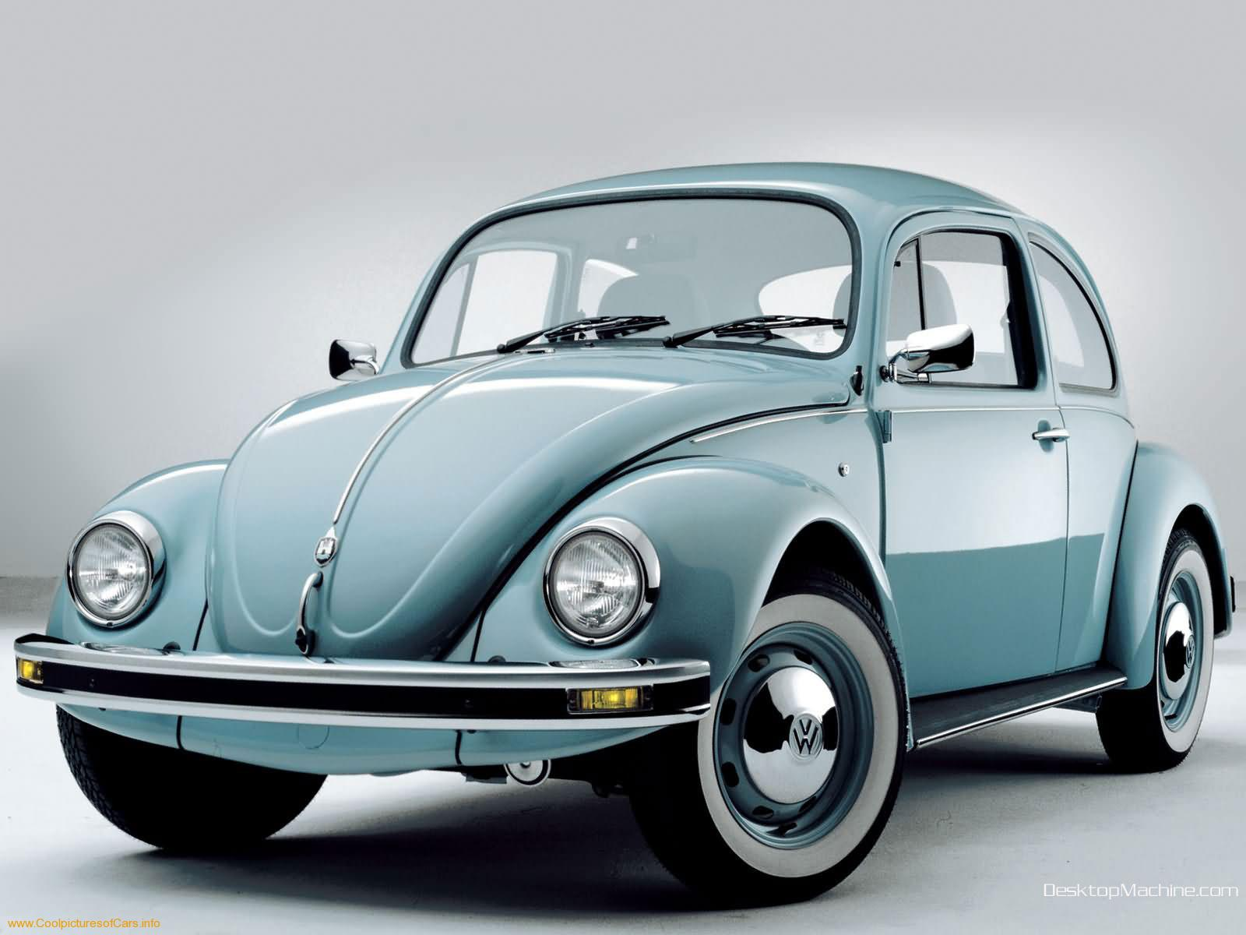
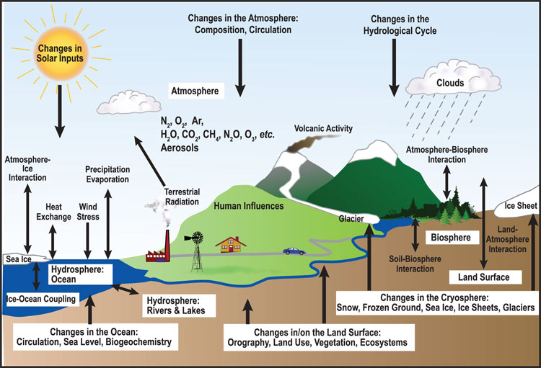
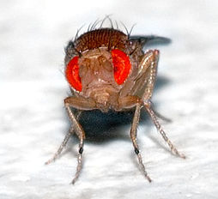
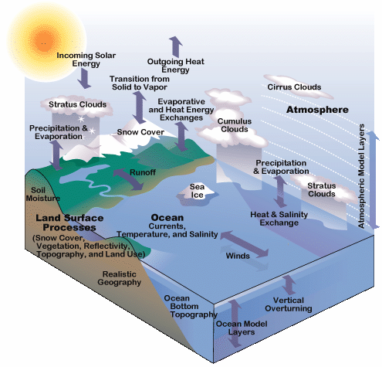
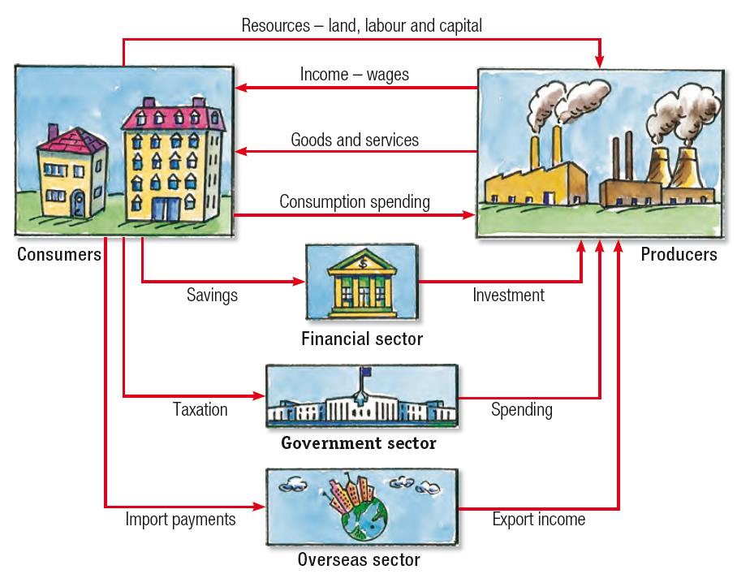
Models: many types
Human
Car
Ecosystem
Ecology & Evolution
Climate
Economy

Slide 59
When you make a model,
you include the
elements that you feel are most important to explain a phenomenon.

Slide 60
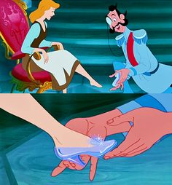
When you make a model,
you include the
elements that you feel are most important to explain a phenomenon.
Generally, we try to make models
that can reproduce real-world data

Slide 61
When you make a model,
you include the
elements that you feel are most important to explain a phenomenon.
Generally, we try to make models
that can reproduce real-world data
In E²M², we distinguish between statistical and mechanistic models

Slide 62
Statistical vs. Mathematical Model
The choice depends on the research question!

Slide 63
Statistical Models
Goal: To rigorously assess the strength of relationship between x and y
Find a significant relationship using a p-value as a measure of relationship strength
Statistical models can demonstrate correlations.

Slide 64
Statistical Models
Goal: To rigorously assess the strength of relationship between x and y (describe patterns)
Find a significant relationship using a p-value as a measure of relationship strength
Statistical models can demonstrate correlations.
Steps:
Formulate a research question
Formulate a hypothesis
Develop a model to demonstrate your hypothesis.
Collect data (required!!!)
Evaluate hypothesis with appropriate statistical tools
t-test, Chi-square, ANOVA
Ordination (PCA)
Regression (LM, GLM, GLMM, GAM)

Slide 65
1. Example Question: What is the trajectory of Malagasy population size through time?
Source: World Bank

Slide 66
1. Example Question: What is the trajectory of Malagasy population size through time?
2. Hypothesis: Malagasy population size increases with time
Source: World Bank

Slide 67

1. Example Question: What is the trajectory of Malagasy population size through time?
2. Hypothesis: Malagasy population size increases with time
3. Statistical Model:
$$y=mx+b$$
Linear Regression
Source: World Bank

Slide 68
1. Example Question: What is the trajectory of Malagasy population size through time?
4. Data:
2. Hypothesis: Malagasy population size increases with time
3. Statistical Model:
$$y=mx+b$$
Linear Regression
Source: World Bank

Slide 69

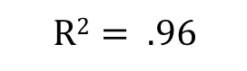


1. Example Question: What is the trajectory of Malagasy population size through time?
4. Data:
2. Hypothesis: Malagasy population size increases with time
3. Statistical Model:
5. Evaluation
Linear Regression
$$y=mx+b$$
$$m= .372 million$$
$$p= .003$$
$$R2= .96$$
What can we conclude from this fitted model?
Source: World Bank

Slide 70

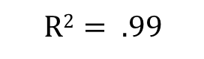


1. Example Question: What is the trajectory of Malagasy population size through time?
7. Adapt your model and re-evaluate:
Exponential Regression
$$y=e^{mx+b}$$
Exponential Regression
$m=0.029$ mil.
$$p<.001$$
$$R2= .99$$
What can we conclude from this fitted model?
Source: World Bank

Slide 71
Statistical Models: Beware!
Statistical models and tests are based on specific assumptions
data normally distributed
y and y independent
etc.

Slide 72
Statistical Models: Beware!
Statistical models and tests are based on specific assumptions
data normally distributed
y and y independent
etc.
Assessing a model means you need to make sure the assumptions are not violated.

Slide 73

Statistical Models: Beware!
Statistical models and tests are based on specific assumptions
data normally distributed
y and y independent
etc.
Assessing a model means you need to make sure the assumptions are not violated.
There are so many statistical models…

Slide 74
Statistical vs. Mathematical Model
The choice depends on the research question!

Slide 75
Mechanistic Models
Goal: To demonstrate the processes that underlie a relationship between x and y
Find a significant relationship using a p-value as a measure of relationship strength
Mechanistic models can demonstrate causation.
Steps:
Formulate a research question
Formulate a hypothesis
Develop a model to demonstrate your hypothesis.
Collect data (for certain questions)
Evaluate the extent to which your model-simulated data matches that from the real world.

Slide 76
1. Example Question: How does Malagasy population size change with time?
2. Hypothesis: Malagasy population size increases because people are having children.
Can you think of an alternative hypothesis?
4. Data:
Source: World Bank

Slide 77

1. Example Question: How does Malagasy population size change with time?
2. Hypothesis: Malagasy population size increases because people are having children.
3. Mechanistic Model:
4. Data:
Population
birth
death
$$P_{t+1}=P_{t}+b∗P_{t} −d∗P_{t}$$
$$P_{t+1}=P_{t}+r∗P_{t}$$
Source: World Bank

Slide 78

1. Example Question: How does Malagasy population size change with time?
2. Hypothesis: Malagasy population size increases because people are having children.
3. Mechanistic Model:
5. Evaluation:
4. Data:
Population
birth
death
$r= .3$49/person/yr
What can we conclude from this fitted model?

Slide 79
Mechanistic Models: Beware!
Parameters used in the mechanistic models sometimes are not measurable!

Slide 80
Mechanistic Models: Beware!
Parameters used in the mechanistic models sometimes are not measurable!
Simulations can be computationally intensive

Slide 81
Mechanistic Models: Beware!
Parameters used in the mechanistic models sometimes are not measurable!
Simulations can be computationally intensive
Advances in computational power often inspire development of more complex models which are not necessarily better

Slide 82
Mechanistic Models: Beware!
Parameters used in the mechanistic models sometimes are not measurable!
Simulations can be computationally intensive
Advances in computational power often inspire development of more complex models which are not necessarily better
“All models are wrong but some are useful…”
-George Box

Slide 83
Mechanistic Models: Beware!
Parameters used in the mechanistic models sometimes are not measurable!
Simulations can be computationally intensive
Advances in computational power often inspire development of more complex models which are not necessarily better
“All models are wrong but some are useful…”
-George Box
We use models to both predict and explain.

Slide 84
It is ideal when statistical and mechanistic models meet:
Mechanistic model
Process
Pattern
Statistical model

Slide 85

A Tool for E²M²
Computer power keeps increasing
Language/software
Fortran, C, C++
Julia, Java, Python
Matlab, Maple, Mathematica,
SAS, SPSS, Stata
Specific programs
Vortex, RAMAS, NetLogo for IBM
NicheMapper for physiology, iLand for forest dynamics
MaxEnt for species distribution modeling
Zonation for reserve selection etc…
The compromise: R---very powerful for
Visualization
Data formatting and sorting
Statistical analyses
Simulation (mechanistic model)

Slide 87
Goals for this lecture
To explain what we’re doing here
To define ”science”
To define ”data”
To define “models”
To introduce many different types of models
Statistical
Mathematical
To introduce the “E” in E²M²
Ecology
Epidemiology

Slide 88
Goals for this lecture
To explain what we’re doing here
To define ”science”
To define ”data”
To define “models”
To introduce many different types of models
Statistical
Mathematical
To introduce the “E” in E²M²
Ecology
Epidemiology

Slide 89
What is Epidemiology?
“the study of what is on the people”
– coined in 1802 to describe diseases in the Spanish population
Emphasis on the study and analysis of the distribution and determinants of health and disease (“risk factors”)

Slide 90
What is Epidemiology?
“the study of what is on the people”
– coined in 1802 to describe diseases in the Spanish population
Emphasis on the study and analysis of the distribution and determinants of health and disease (“risk factors”)

Slide 91
Models in Epidemiology
Sickness caused by an imbalance in the four humors (Hippocrates)

Slide 92
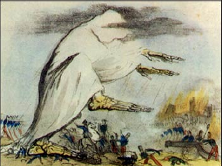
Models in Epidemiology
Sickness caused by an imbalance in the four humors (Hippocrates)
Miasmatic theory of disease (1500s)
Sickness results from emanations of ‘bad air’

Slide 93
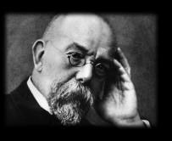
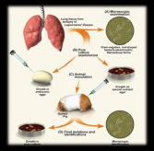
Models in Epidemiology
Sickness caused by an imbalance in the four humors (Hippocrates)
Miasmatic theory of disease (1500s)
Sickness results from emanations of ‘bad air’
Germ theory of disease
Leeuwenhoek’s microscope (1675)
Koch’s postulates (1890)

Slide 94
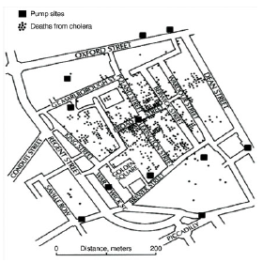
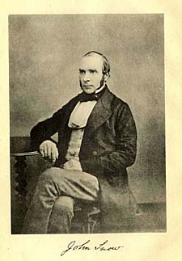
Models in Epidemiology
Sickness caused by an imbalance in the four humors (Hippocrates)
Miasmatic theory of disease (1500s)
Sickness results from emanations of ‘bad air’
Germ theory of disease
Leeuwenhoek’s microscope (1675)
Koch’s postulates (1890)
Classical epidemiology
John Snow and London cholera (1854)

Slide 95
Models in Epidemiology
Sickness caused by an imbalance in the four humors (Hippocrates)
Miasmatic theory of disease (1500s)
Sickness results from emanations of ‘bad air’
Germ theory of disease
Leeuwenhoek’s microscope (1675)
Koch’s postulates (1890)
Classical epidemiology
John Snow and London cholera (1854)
Mathematical epidemiology
Kermack and McKendrik (1927)
γ
S
βI or
βI/N
I
R
Susceptible
Infectious
Recovered

Slide 96
What is Ecology?
The study of the interactions of organisms and their environment
Coined in 1866 by German scientist Ernst Haeckel
Nile crocodiles opening mouths for sandpipers (Herodotus)
Emphasis on explaining dynamical processes in nature

Slide 97
Models in Ecology
Origins in plant biology and succession
Clements and Gleason (1910s-20s)

Slide 98
Models in Ecology
Origins in plant biology and succession
Clements and Gleason (1910s-20s)
Food Chains
- Charles Elton (1920s)

Slide 99
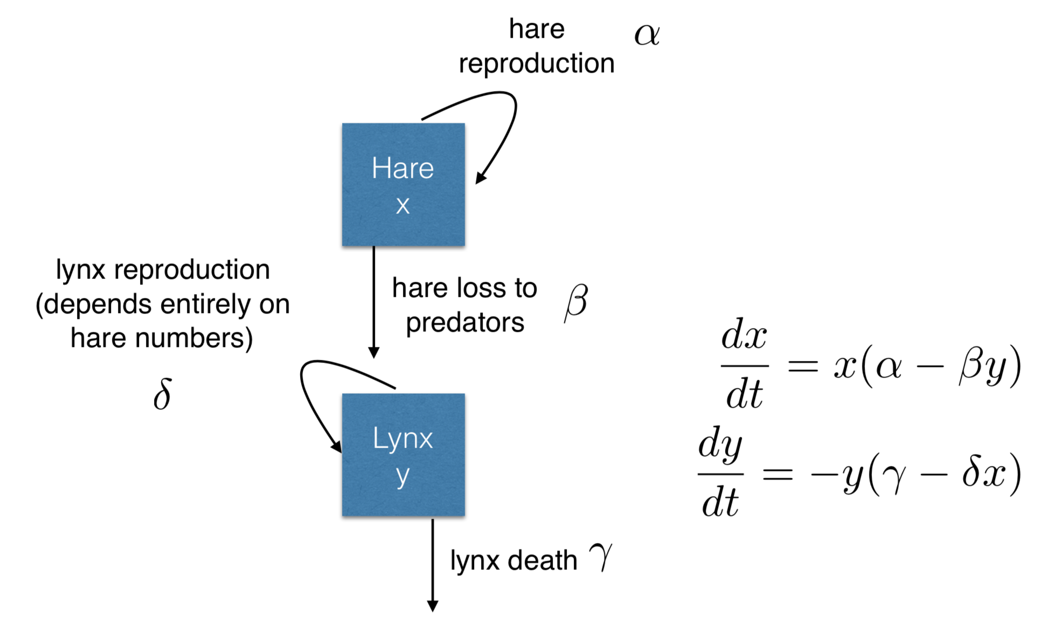
Models in Ecology
Origins in plant biology and succession
Clements and Gleason (1910s-20s)
Food Chains
- Charles Elton (1920s)
Predator-Prey Dynamics
- Lotka-Voltera (1920s)

Slide 100
Models in Ecology
Origins in plant biology and succession
Clements and Gleason (1910s-20s)
Food Chains
- Charles Elton (1920s)
Predator-Prey Dynamics
- Lotka-Voltera (1920s)
Mathematical Ecology
Robert MacArthur (1950s)
Island biogeography

Slide 101
Models in Ecology
Origins in plant biology and succession
Clements and Gleason (1910s-20s)
Food Chains
- Charles Elton (1920s)
Predator-Prey Dynamics
- Lotka-Voltera (1920s)
Mathematical Ecology
Robert MacArthur (1950s)
Island biogeography
Disease Ecology
Anderson and May (1980s)
Island biogeography
γ
S
βI or
βI/N
I
R
Susceptible
Infectious
Recovered

Slide 102
Misaotra!

